Slide 1
Title IMPROVING IMAGING BY USING GENETIC ALGORITHMS TO FIND ARBITRARY PROFILES OF BESSEL BEAM LASER by Leon Hunter Project Advisors Dr. Tomasz Smolinski Dr. Thomas Planchon

Slide 2
Overview
Background
Optics
Adaptive optics
Active optic devices
Laser Shape
Genetic Algorithms
What is?
Structure
Components
Objective of Project
Experiment
Without Toolbox
Write rough Genetic Algorithm script
Write Laser Propagation script
Write Fitness Function to evaluate similarity between planes
Write appropriate output function to document results
With Toolbox
Rewrite equivalent Genetic Algorithm script
Rewrite equivalent Fitness Function script
Set appropriate option values
Write appropriate output function to document results
Find best parameter values for convergence
Plug in found values to original (no toolbox) script
Compare convergence from script without toolbox to script with toolbox
Results
Hardware
Software

Slide 3
Overview
Background
adaptive optics
laser shape
genetic algorithm1
genetic algorithm2
genetic algorithm3
Objective
Experiment
Chromosomes
Genes
fitness function
planes as vectors
setting GA options
Results
without toolbox
with toolbox
Demo
without toolbox
with toolbox
Future Work
immediate - interface algorithm to SLM
Distant - apply solution to cymatic problems in other fields

Slide 4
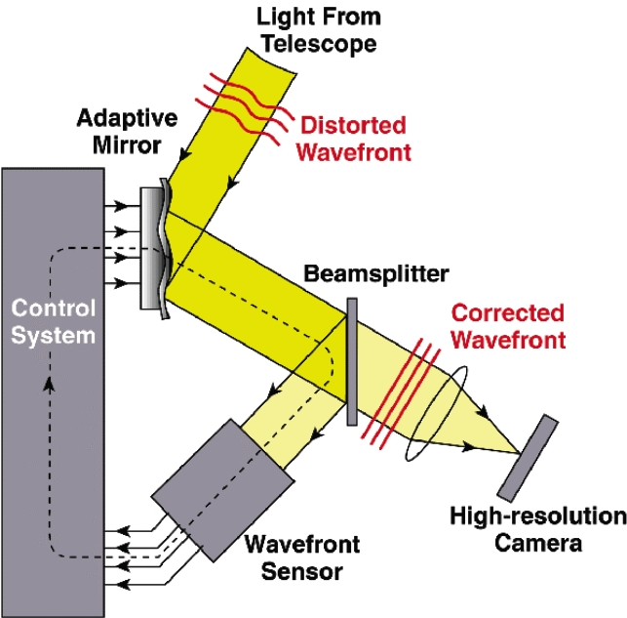
Background; Adaptive Optics
Process to enhance the performance of an optical system
Reduces effect of wave front distortions using active optic
Active optics is an optical instrument with an adjustable reflective component; i.e. – spatial light modulator (SLM)
actively shapes reflective surface to prevent deformation due to external influences.

Slide 5
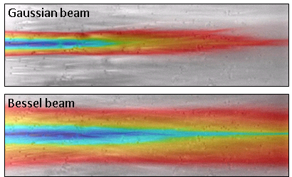
Background; Laser Shape
Naturally, the shape of laser follows Gaussian function. However, there is interest to use Bessel-shaped beams to improve measuring techniques.
Gaussian: stays bounded over propagation range, then diverges
Bessel: Ideally diffraction-free and does not diverge when propagating
Notice the information-rich areas in the images below
Notes:
The point spread function (PSF) describes the response of an imaging system to a point source or point object. - how well you can see two nearby objects before they appear to be one object

Slide 6
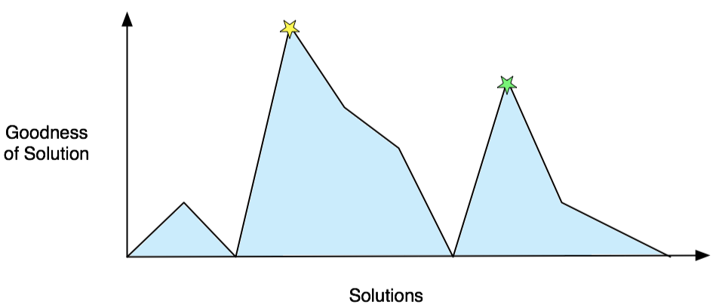
Background; Genetic Algorithm
A genetic algorithm (GA) is a search technique used in computing to find exact or approximate solutions to optimization and search problems.
If you can quantify the worth of a solution, it is useful to use a genetic algorithm as it can perform a search of the solution space.
Notes:
The graph above displays how a set of values for solutions may be scored (quantified) based on some arbitrary criteria. The two stars denote the two most optimal solutions found.

Slide 7
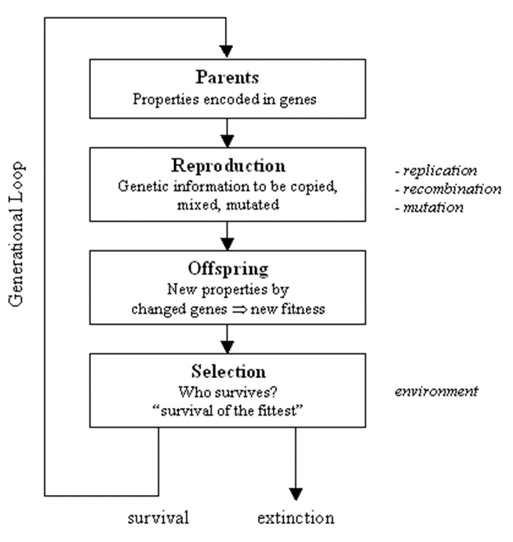
Background; Genetic Algorithm
10 different phase functions ϕ(x,y) - Each phase function (parent) will be sent to SLM
Makings of Genetic Algorithms include parents¹, reproduction², offspring³, and selection⁴.
1. Parents - contain properties (DNA) to be reproduced and passed to offspring who may or may not survive depending on fitness for environment.
2. Reproduction – process of parents’ genetic information being copied, mixed, and mutated.
3. Offspring - resulting entities whose properties are yielded by reproduction
4. Selection - actions to decide which offspring is most suited for parenting.
**Note: Evolution of the contending solution(s) occurs over many generations.
Notes:
• Optimization of active optics controlled by genetic algorithms
• Genetic algorithms - type of optimization algorithm that grades potential solutions based on fitness and ability to survive in environment.
• Fitness function - the environment entities are being tested against.

Slide 8
Background; Genetic Algorithm
Chromosomes are potential genetic solutions; they are the “parents” of the genetic algorithm.
Genetic solutions are the value sets that satisfy a genetic algorithm.
In genetic algorithms , a gene is a single variant in a chromosome.

Slide 9
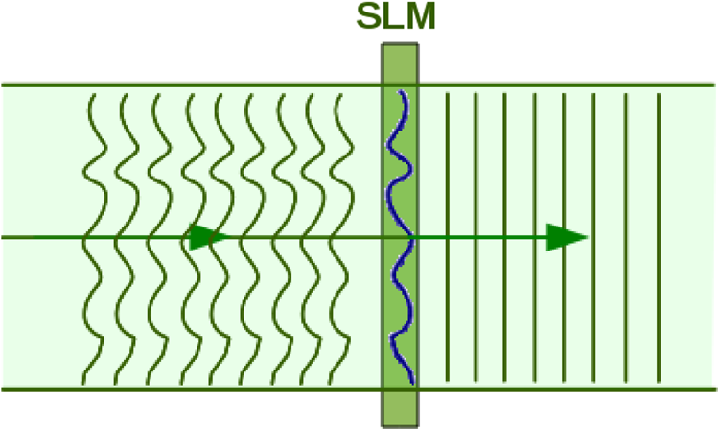
Objective
Imaging a specimen with high intensity guassian emission can cause biological samples to be destroyed during an experiment.
In Dr. Planchon’s Lab, Caenorhabditis elegans (C. elegans) are imaged to analyze tissue samples, cells, etc.
The objective is to develop an algorithm that will be able to converge an arbitrary profile of a phase from a spatial light modulator such that the three planes (before focal point, at focal point, and after focal point) have very similar light intensity.

Slide 10
Experiment; Chromosomes
For the experiment at hand, we simulate the data using a script to simulate the propagation of a light wave by passing a random polynomial function to the SLM.
The function values are treated as a single chromosome of the genetic algorithm.

Slide 11
Experiment; Genes
Each plane is represented by a vector of length N. (Where N is the degree of the polynomial function or number of genes). Each term in the polynomial function corresponds to a value in the vector. In the experiment, each of these terms is considered a gene.

Slide 12
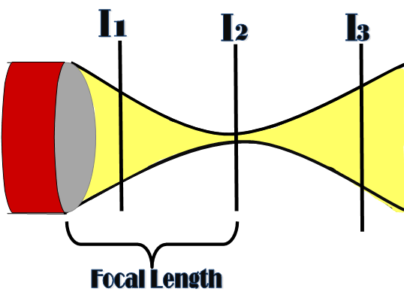
Experiment; Fitness Function
After simulating the propagation, 3 planes of the light ray are evaluated. The evaluation determines the likeness of each plane. The similarity is determined by average absolute difference of each respective plane.
Comparisons are as follows: the first plane to the second, the first to the last, and the second to the last.

Slide 13
Experiment; Planes as Vectors
The values of the vector represent the intensity of light or photon distribution at the given point. The index of the vector represents the spatial position of the specified point. Elements whose index is close to the median index of vector have greater values. As elements’ indices depart from the median, their values lessen; the photon distribution lessens.

Slide 14
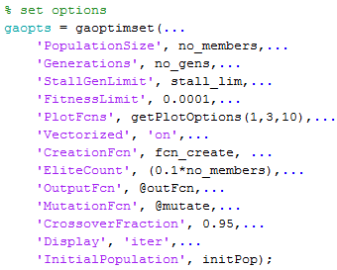
Experiment; Setting GA options
Population size – Size of population per generation
Generations – Number of generations before stalling algorithm
StallGenLimit – Number of consecutive generations without improvement before stalling algorithm
FitnessLimit – Stall algorithm if a solution has a fitness score less than specified value
PlotFcns – Data to plot per generation 1) Best Fitness Value from local generation 3) Diversity of 10) Scores of each solution in local generation
Vectorized – ‘on’ if fitness function:
Accepts a matrix with an arbitrary number of rows.
Returns vector of function values of each row.
CrossoverFraction – Likelihood of hybridizing new solutions with elites
EliteCount – Number of individuals in the current generation are guaranteed to survive to the next generation
OutputFcn – Function to be called every iteration of GA
MutationFcn – How to produce mutated solutions
Display – How to display; iterative display shows output of each generation
InitialPopulation – Population used to seed GA

Slide 15
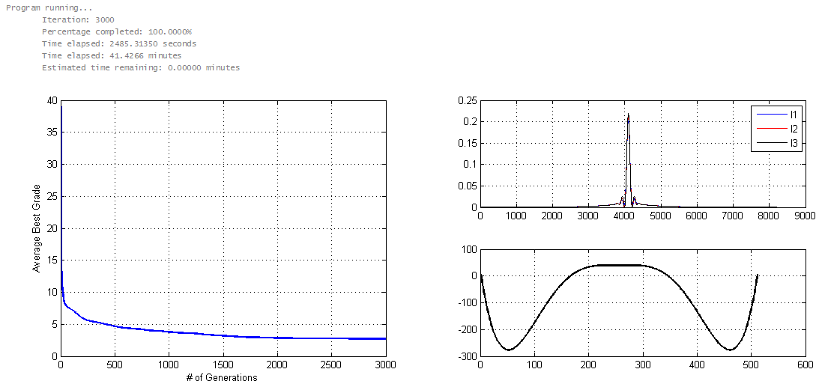
Results; Without toolbox

Slide 16
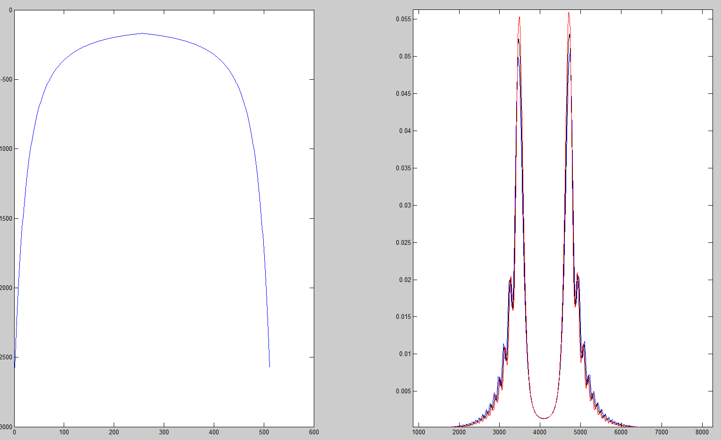
Results; With toolbox
report0 =
-----------EXECUTION FINISHED-----------
Best score: 1.57694
Time elapsed: 21.35001 seconds
report1 =
-----------EXECUTION FINISHED-----------
Best score: 5.28911
Time elapsed: 31.05714 seconds

Slide 17
Demo; Without toolbox

Slide 18
Demo; With toolbox

Slide 19
Future Work; Interface Algorithm to SLM
Control spatial light modulator (SLM) used for shaping profile of laser beam
Measure result of shaping with 2D camera.
Spatial light modulator – device used to modulate amplitude, phase, or polarization of light waves in space and time.
LCD with crystals capable of orienting themselves at an angle signaled by voltage.
Can be programmed to change index of an image
Values of index within set { x ∈ Z : 0 ≤ x ≤ 2¹⁶ }
Notes:
i.e. - hydrodynamics, acoustics

Slide 20
Future Work
Apply solution to various fields of science who are faced with similar issues that can be solved by correcting wave front distortions.

Slide 21
Thank you!
Questions?

